Slide 1


R. GLENN HUBBARD
ANTHONY PATRICK O’BRIEN
FIFTH EDITION
© 2015 Pearson Education, Inc.

Slide 2
Monetary Policy

Slide 3
What can the Federal Reserve do?
Last chapter we introduced the monetary policy tools that the Federal Reserve can use to influence the money supply.
Now we will address how and why the Fed takes the actions that it does.
We will also pay special attention to the unique circumstances surrounding the recession of 2007-2009, and the Fed’s response to those circumstances.

Slide 4
What is Monetary Policy?
15.1
Define monetary policy and describe the Federal Reserve’s monetary policy goals.

Slide 5
What is the role of the Federal Reserve?
When the Federal Reserve was created in the 1913, its main responsibility was to prevent bank runs.
After the Great Depression of the 1930s, Congress gave the Fed broader responsibilities: to act “so as to promote effectively the goals of maximum employment, stable prices, and moderate long-term interest rates.”
Since World War II, the Fed has carried out an active monetary policy.
Monetary policy: The actions the Federal Reserve takes to manage the money supply and interest rates to pursue macroeconomic policy goals.

Slide 6
The goals of monetary policy
The Fed pursues four main monetary policy goals:
Price stability
High employment
Stability of financial markets and institutions
Economic growth
We will consider each goal in turn.

Slide 7
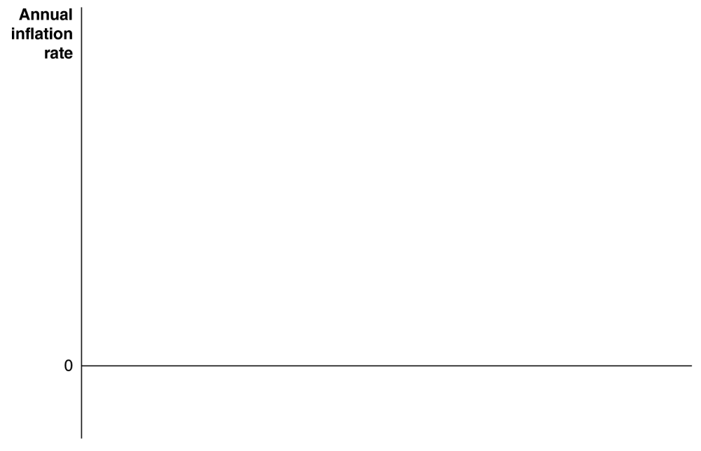

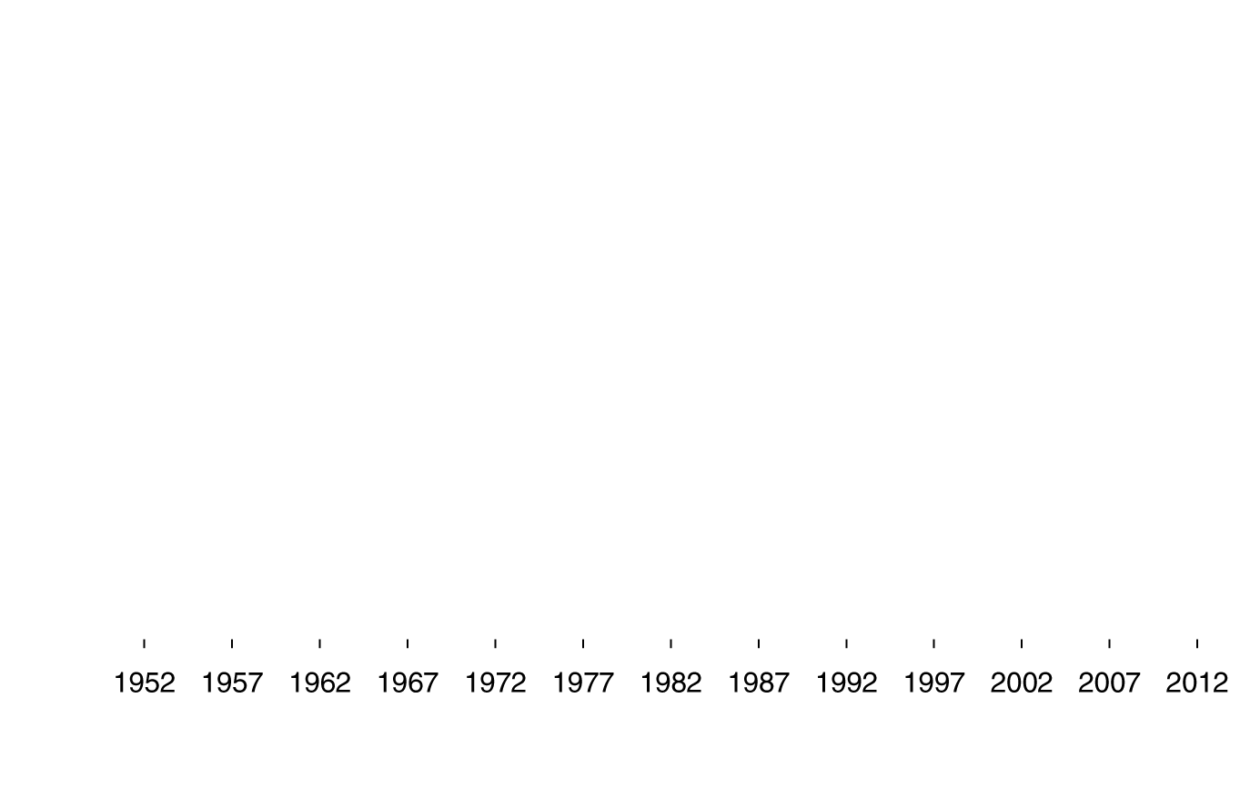
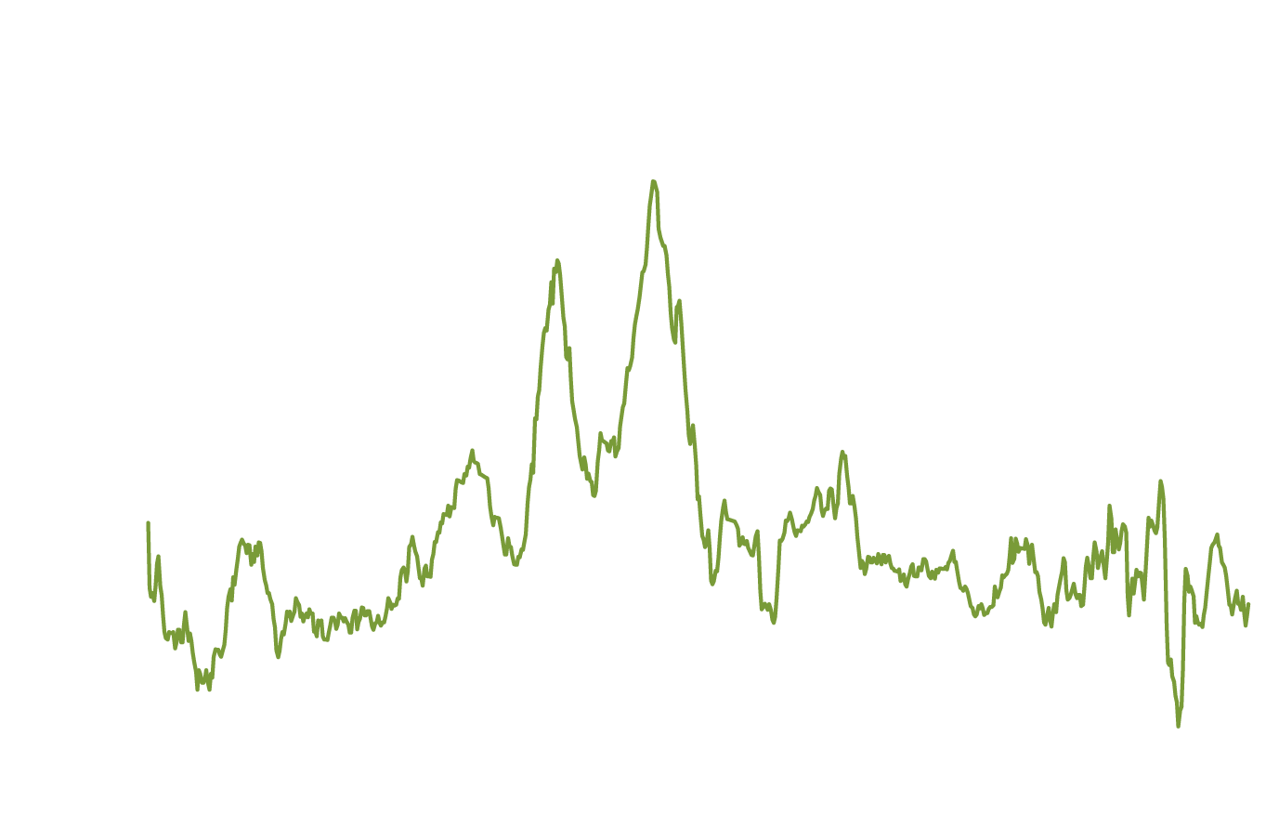
Fed goal #1: Price stability
The figure shows CPI inflation in the United States.
Since rising prices erode the value of money as a medium of exchange and a store of value, policymakers in most countries pursue price stability as a primary goal.
After the high inflation of the 1970s, then Fed chairman Paul Volcker made fighting inflation his top policy goal. To this day, price stability remains a key policy goal of the Fed.
Figure 15.1
The inflation rate, January 1952-June 2013
Notes:
For most of the 1950s and 1960s, the inflation
rate in the United States was 4 percent
or less. During the 1970s, the inflation rate
increased, peaking during 1979–1981,
when it averaged more than 10 percent. After
1992, the inflation rate was usually less
than 4 percent, until increases in oil prices
pushed it above 5 percent during summer
2008. The effects of the recession caused
several months of deflation—a falling price
level—during early 2009.
Note: The inflation rate is measured as the
percentage change in the consumer price index
from the same month in the previous year.
Source: Federal Reserve Bank of St. Louis.

Slide 8
Fed goal #2: High employment
At the end of World War II, Congress passed the Employment Act of 1946, which stated that it was the:
“responsibility of the Federal government… to foster and promote… conditions under which there will be afforded useful employment, for those able, willing, and seeking to work, and to promote maximum employment, production, and purchasing power.”
Thus price stability and high employment are often referred to as the dual mandate of the Fed.

Slide 9
Fed goal #3: Stability of financial markets and institutions
Stable and efficient financial markets are essential to a growing economy.
The Fed makes funds available to banks in times of crisis, ensuring confidence in those banks.
In 2008, the Fed temporarily made these discount loans available to investment banks also, in order to ease their liquidity problems.

Slide 10
Fed goal #4: Economic growth
Stable economic growth encourages long-run investment, which is itself necessary for growth.
It is not clear to what extent the Fed can really encourage long-run investment, beyond meeting the previous three goals; Congress and the President may be in a better position to address this goal.

Slide 11
The Money Market and the Fed’s Choice of Monetary Policy Targets
15.2
Describe the Federal Reserve’s monetary policy targets and explain how expansionary and contractionary monetary policies affect the interest rate.

Slide 12
Monetary policy tools and targets
The Fed has three monetary policy tools at its disposal:
Open market operations
Discount policy
Reserve requirements
It uses these tools to try to influence the unemployment and inflation rates.
It does this by directly influencing its monetary policy targets:
The money supply
The interest rate (primary monetary policy target of the Fed)
Note: During the recession of 2007-2009, the Fed developed new policy tools. For now, we are addressing how the Fed carries out monetary policy during “normal” times.

Slide 13

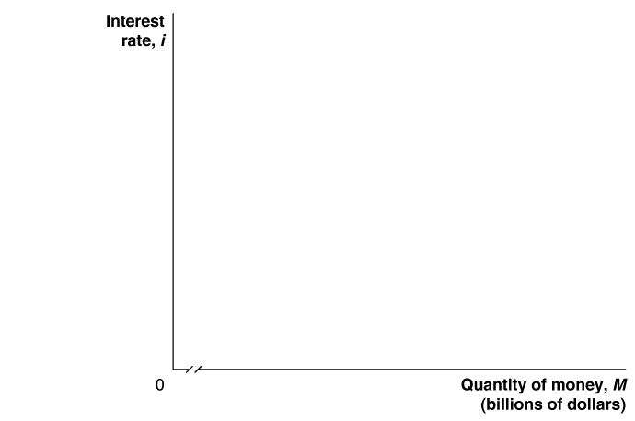
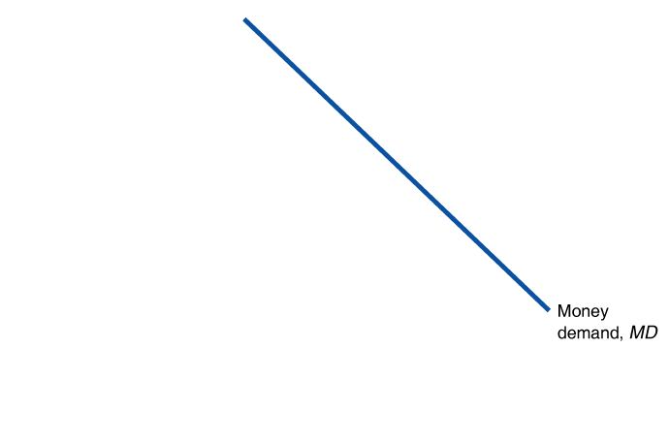
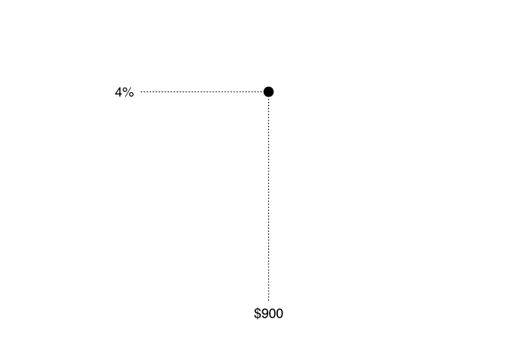
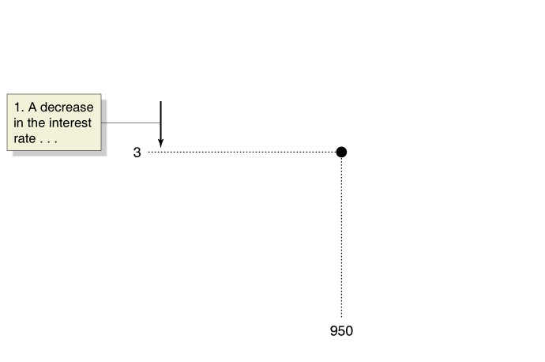
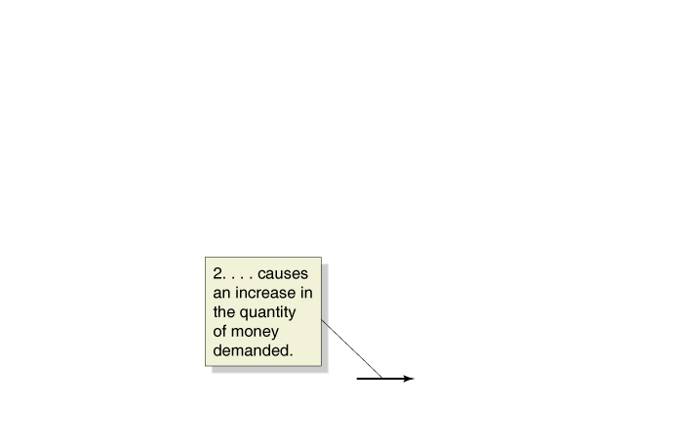
The demand for money
The Fed’s two monetary policy targets are related in an important way:
Higher interest rates result in a lower quantity of money demanded.
Why? When the interest rate is high, alternatives to holding money begin to look attractive—like U.S. Treasury bills.
So the opportunity cost of holding money is higher when the interest rate is high.
Figure 15.2
The demand for money
Notes:
The money demand curve slopes downward
because a lower interest rate causes households
and firms to switch from financial assets
such as U.S. Treasury bills to money. All
other things being equal, a fall in the interest
rate from 4 percent to 3 percent will increase
the quantity of money demanded from
$900 billion
to $950 billion. An increase in
the interest rate will decrease the quantity of
money demanded.

Slide 14

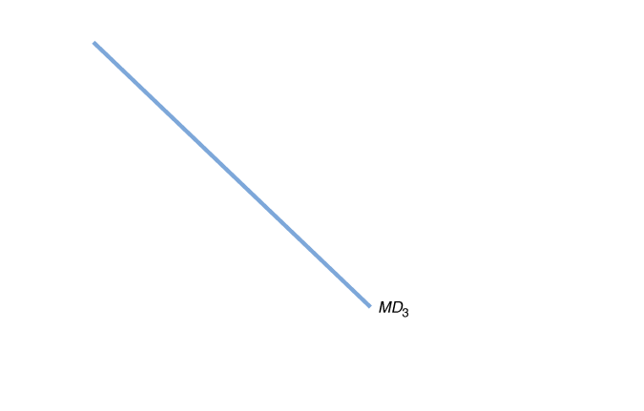
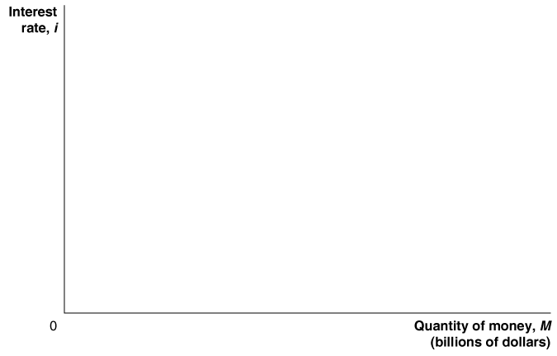
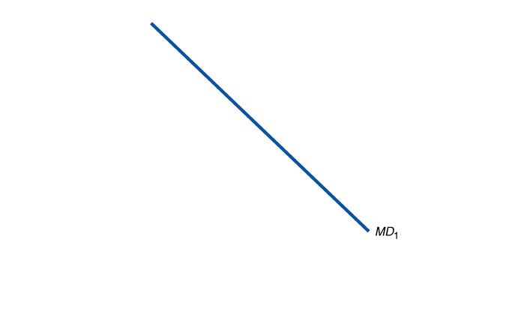
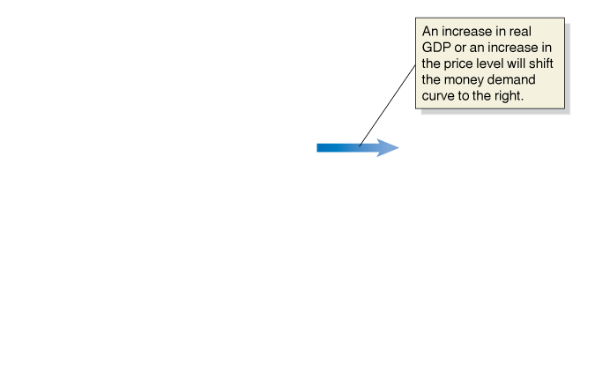
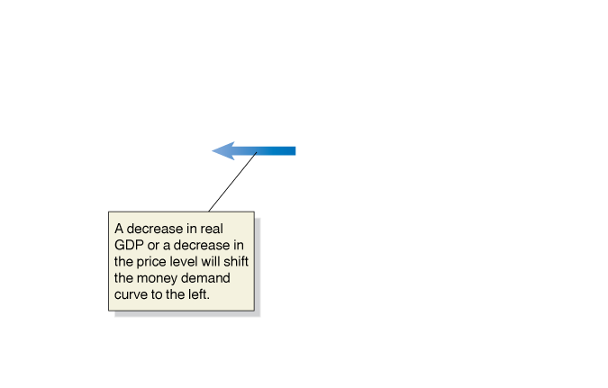
Shifts in the money demand curve
What could cause the money demand curve to shift?
A change in the need to hold money, to engage in transactions.
For example, if more transactions are taking place (higher real GDP) or more money is needed for each transaction (higher price level), the demand for money will be higher.
Decreases in real GDP or the price level decrease money demand.
Figure 15.3
Shifts in the money demand curve
Notes:
Changes in real GDP or the price level cause
the money demand curve to shift. An increase
in real GDP or an increase in the
price level will cause the money demand
curve to shift from MD1 to MD2. A decrease
in real GDP or a decrease in the price level
will cause the money demand curve to shift
from MD1 to MD3.

Slide 15
How does the Fed manage the money supply?
We saw in the previous chapter that the Fed alters the money supply by buying and selling U.S. Treasury securities.
To increase the money supply, the Fed buys those securities; the sellers deposit the sale proceeds in a checking account, and the money gets loaned out—increasing the money supply.
Decreasing the money supply would require selling securities.

Slide 16

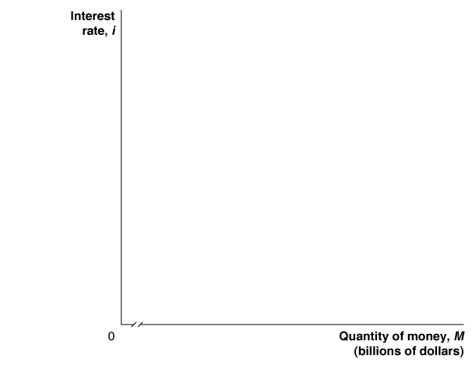
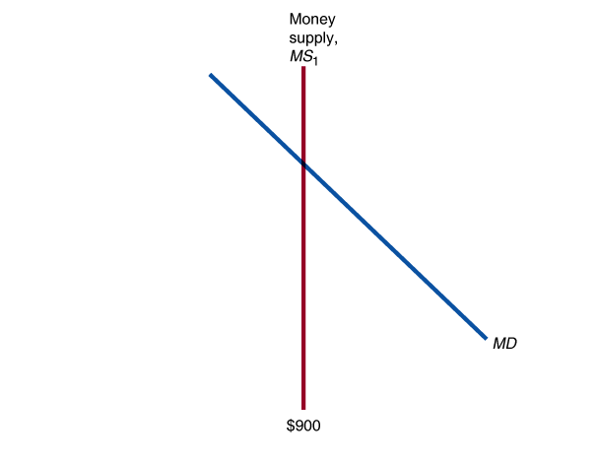
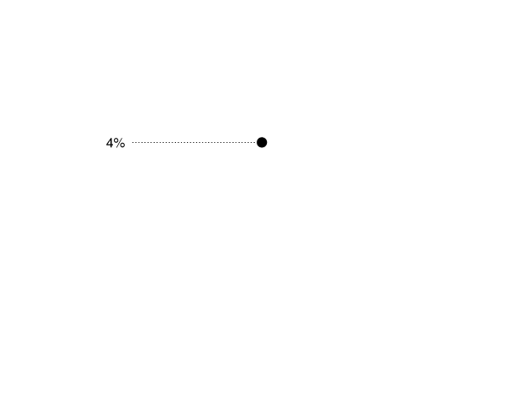
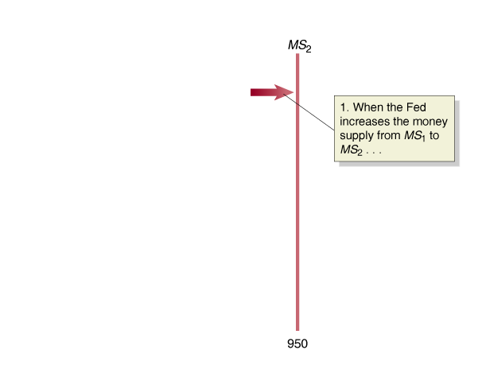
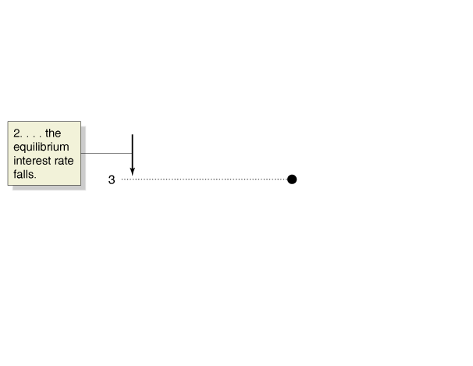
Equilibrium in the money market
For simplicity, we assume the Fed can completely control the money supply.
Then the money supply curve is a vertical line—it does not depend on the interest rate.
Equilibrium occurs in the money market where the two curves cross.
When the Fed increases the money supply, the short-term interest rate must fall until it reaches a level at which households and firms are willing to hold the additional money.
Figure 15.4
The effect on the interest rate when the Fed increases the money supply
Notes:
When the Fed increases the money supply,
households and firms will initially hold
more money than they want, relative to
other financial assets. Households and firms
use the money they don’t want to hold to
buy Treasury bills and make deposits in
interest-paying bank accounts. This increase
in demand
allows banks and sellers
of Treasury bills and similar securities to
offer lower interest rates. Eventually, interest
rates will fall enough that households and
firms will be willing to hold the additional
money the Fed has created. In the figure,
an increase in the money supply from $900
billion
to $950 billion causes the money supply
curve to shift to the right, from MS1 to
MS2, and causes the equilibrium interest
rate to fall from 4 percent to 3 percent.

Slide 17

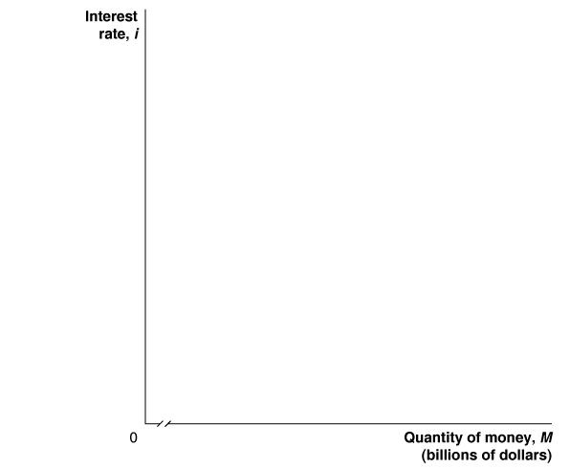
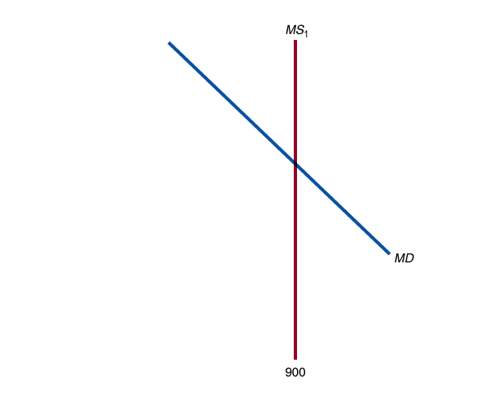
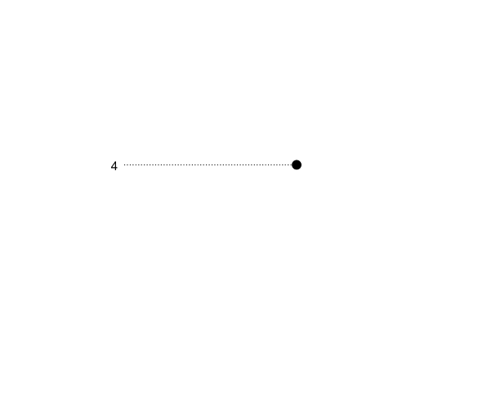
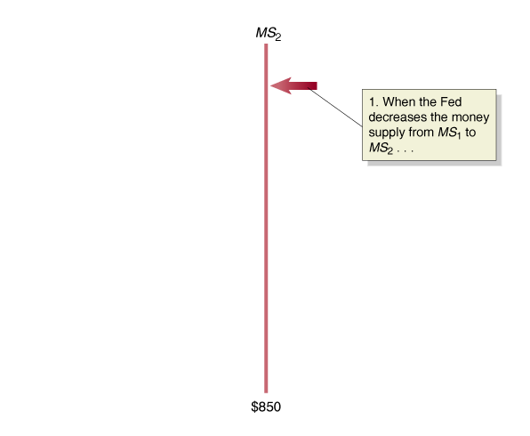
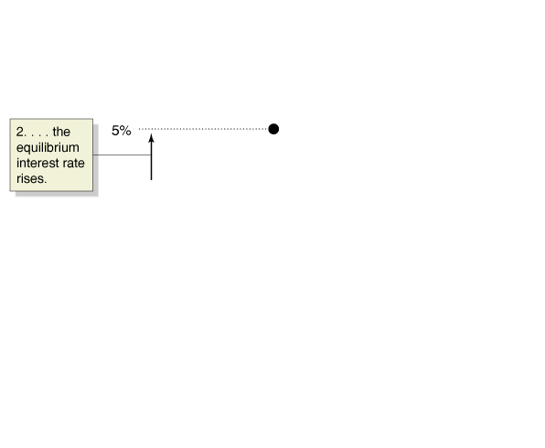
Equilibrium in the money market
Alternatively, the Fed may decide to lower the money supply, by selling Treasury securities.
Now firms and households (who bought the securities with money) hold less money than they want, relative to other financial assets.
In order to retain depositors, banks are forced to offer a higher interest rate on interest-bearing accounts.
Figure 15.5
The effect on the interest rate when the Fed decreases the money supply
Notes:
When the Fed decreases the money supply,
households and firms will initially hold less
money than they want, relative to other
financial
assets. Households and firms will
sell Treasury bills and other financial assets
and withdraw money from interest-paying
bank accounts. These actions will increase
interest rates. Interest rates will rise to the
point at which households and firms will
be willing to hold the smaller amount of
money that results from the Fed’s actions. In
the figure, a reduction in the money supply
from $900 billion to $850 billion causes the
money supply curve to shift to the left, from
MS1 to MS2, and causes the equilibrium
interest rate to rise from 4 percent to
0 5 percent.

Slide 18
A tale of two interest rates
We now have two models of the interest rate:
The loanable funds model (chapter 21)
Concerned with long-term real rate of interest
Relevant for long-term investors (firms making capital investments, households building new homes, etc.)
The money market model (this chapter)
Concerned with short-term nominal rate of interest
Most relevant for the Fed: changes in money supply directly affect this interest rate
Usually, the two interest rates are closely related; an increase in one results in the other increasing also.

Slide 19
Choosing a monetary policy target
The Fed can choose to target a particular level of the money supply, or a particular short-term nominal interest rate.
It concentrates on the interest rate, in part because the relationship between the money supply (M1 or M2) and real GDP growth broke down in the early 1980s (M1) and 1990s (M2).
There are many different interest rates in the economy; the Fed targets the federal funds rate: the interest rate banks charge each other for overnight loans.
The Fed does not set the federal funds rate; but rather affects the supply of bank reserves through open market operations.

Slide 20


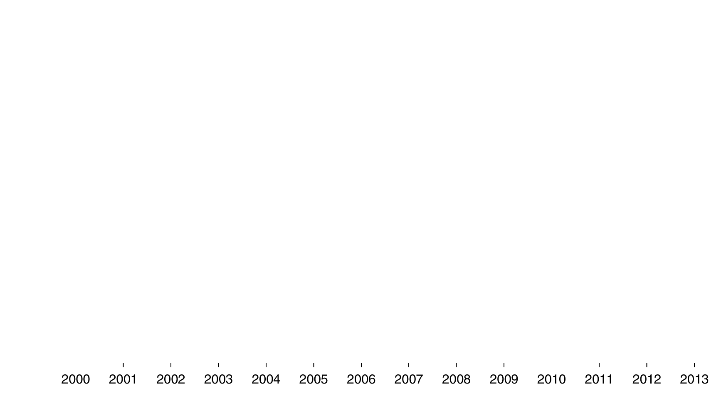
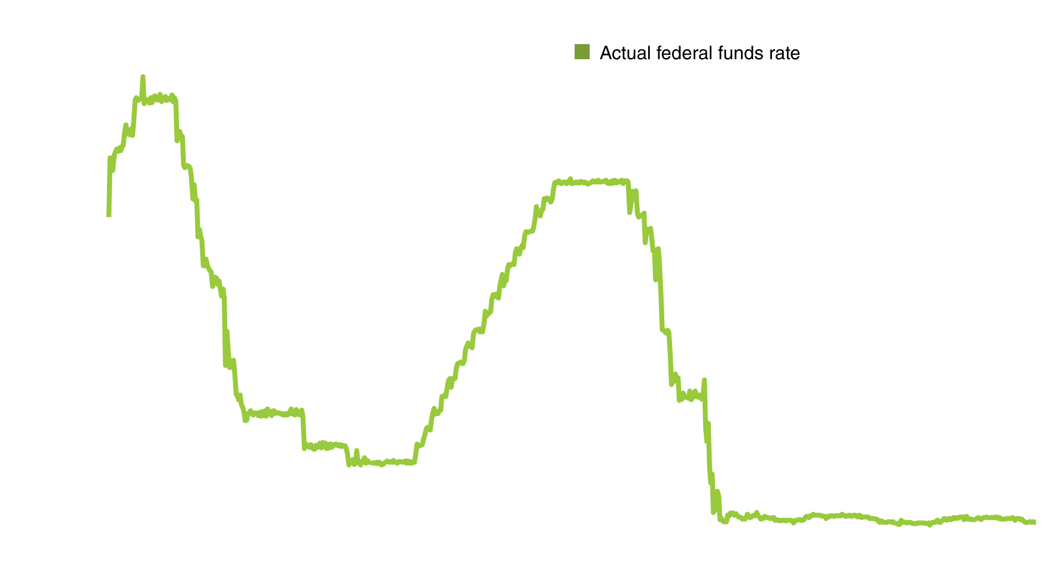
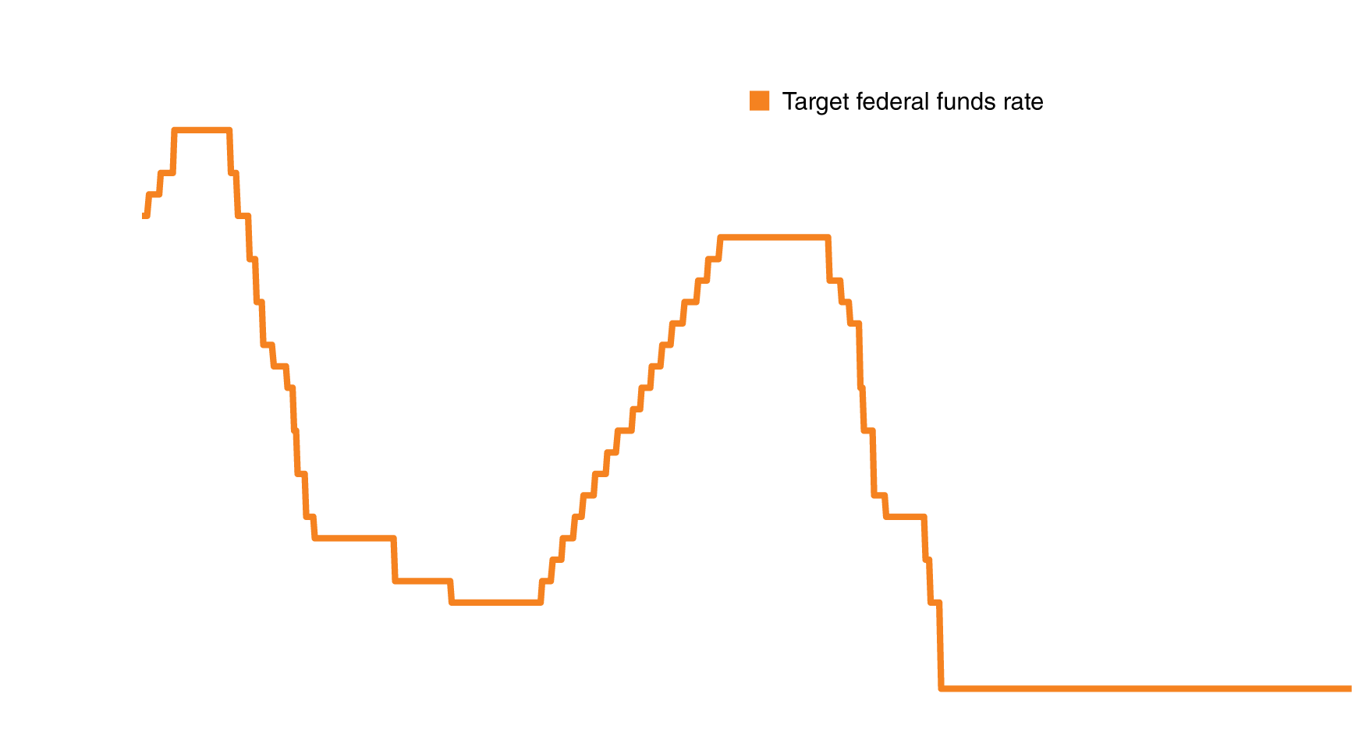
Federal funds rate targeting
Figure 15.6
Federal funds rate targeting, January 2000-July 2013
Although it does not directly set the federal funds rate, through open market operations the Fed can control it quite well.
From December 2008, the target federal funds rate was 0-0.25%.
The low federal funds rate was designed to encourage banks to make loans instead of holding excess reserves, which banks were holding at unusually high levels.
Notes:
The Fed does not set the federal funds rate. However, the Fed’s ability to increase
or decrease bank reserves quickly through open market operations keeps the
actual
federal funds rate close to the Fed’s target rate. The orange line is the Fed’s
target for the federal funds rate, and the jagged green line represents the actual
value for the federal funds rate on a weekly basis.
Note: The federal funds target for the period after December 2008 was
0 to 0.25 percent.
Source: Board of Governors of the Federal Reserve System.

Slide 21
Monetary Policy and Economic Activity
15.3
Use aggregate demand and aggregate supply graphs to show the effects of monetary policy on real GDP and the price level.

Slide 22
How interest rates affect aggregate demand
Interest rates affect aggregate demand through:
Consumption
Lower interest rates encourage buying on credit, which typically affects the sale of durables. Lower rates also discourage saving.
Investment
Lower interest rates encourage capital investment by firms:
By making it cheaper to borrow (sell corporate bonds).
By making stocks more attractive for households to purchase, allowing firms to raise funds by selling additional stock.
Lower rates also encourage new residential investment.
Net exports
High U.S. interest rates attract foreign funds, raising the $US exchange rate, causing net exports to fall; and vice versa.

Slide 23
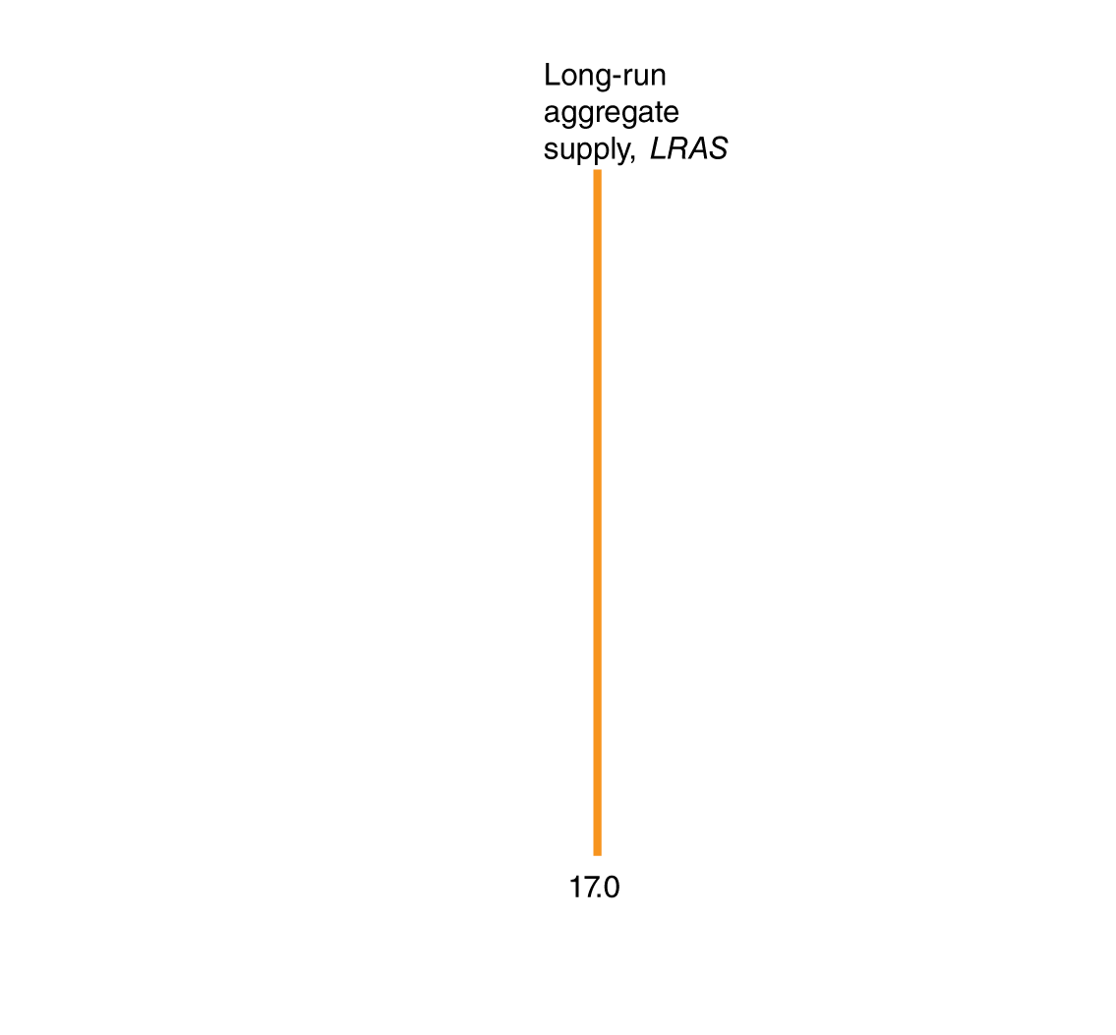

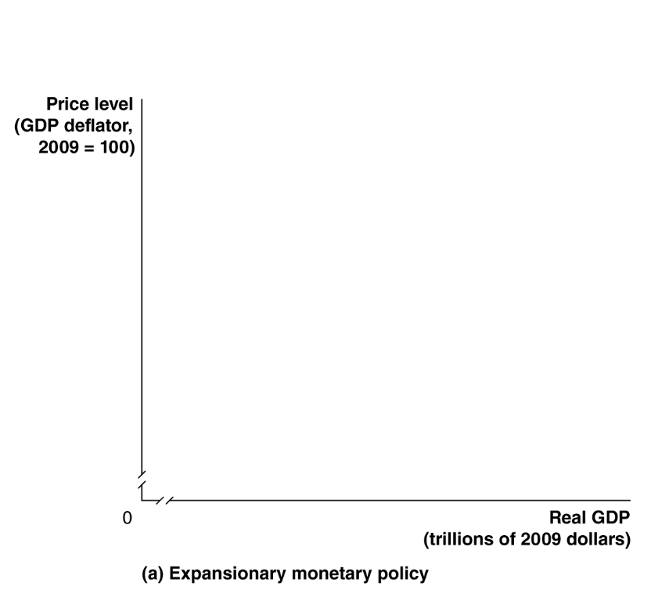
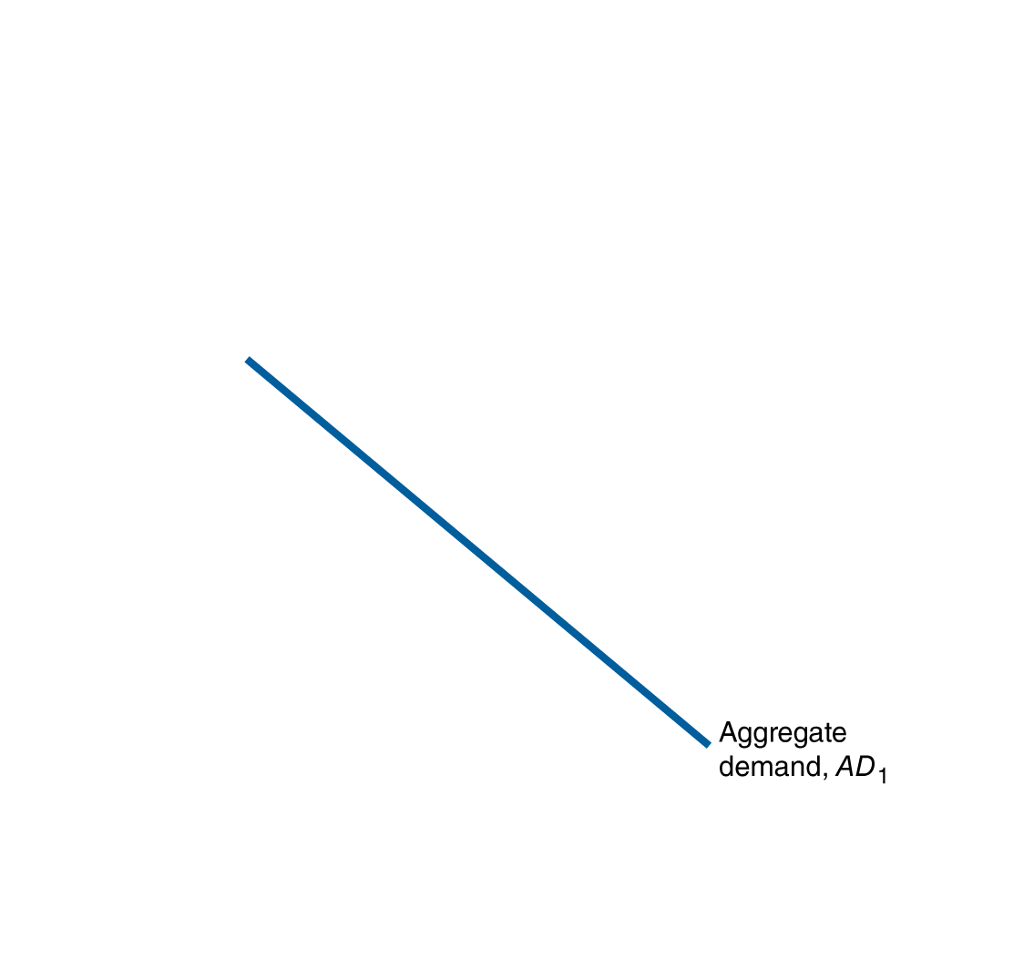
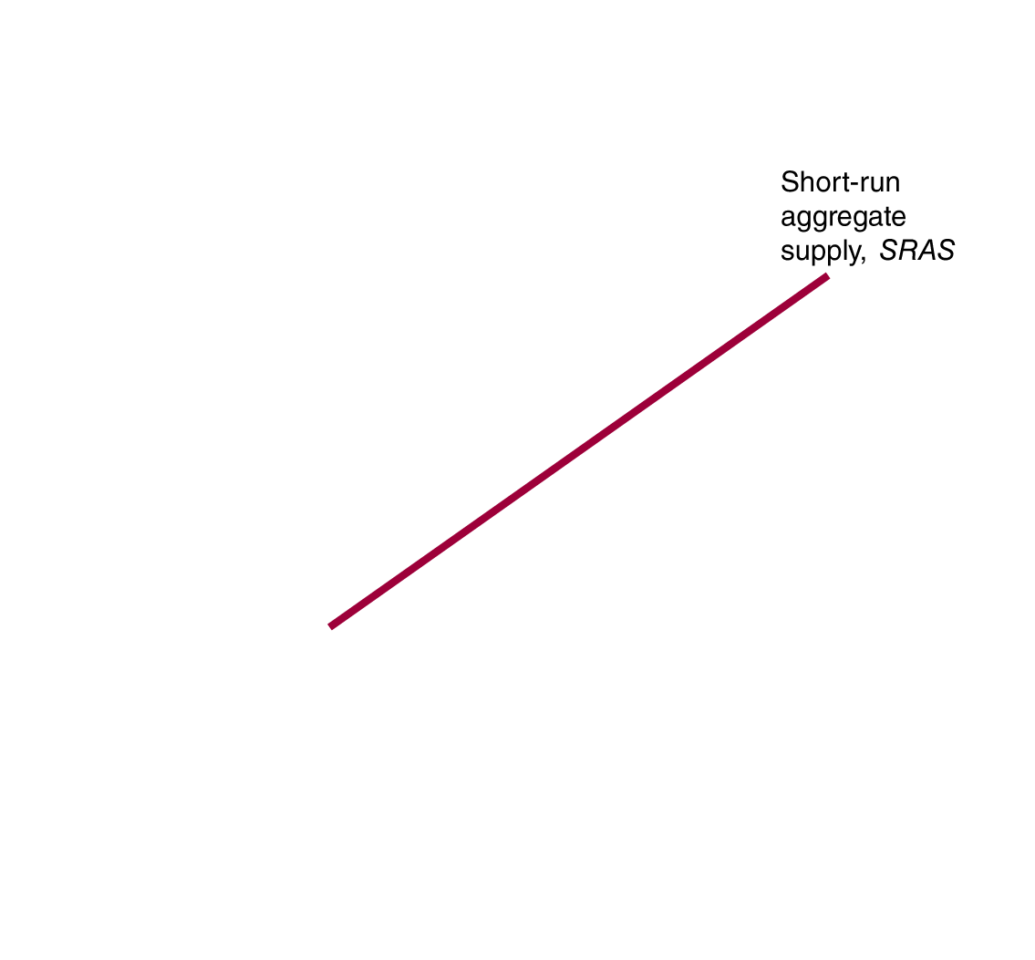
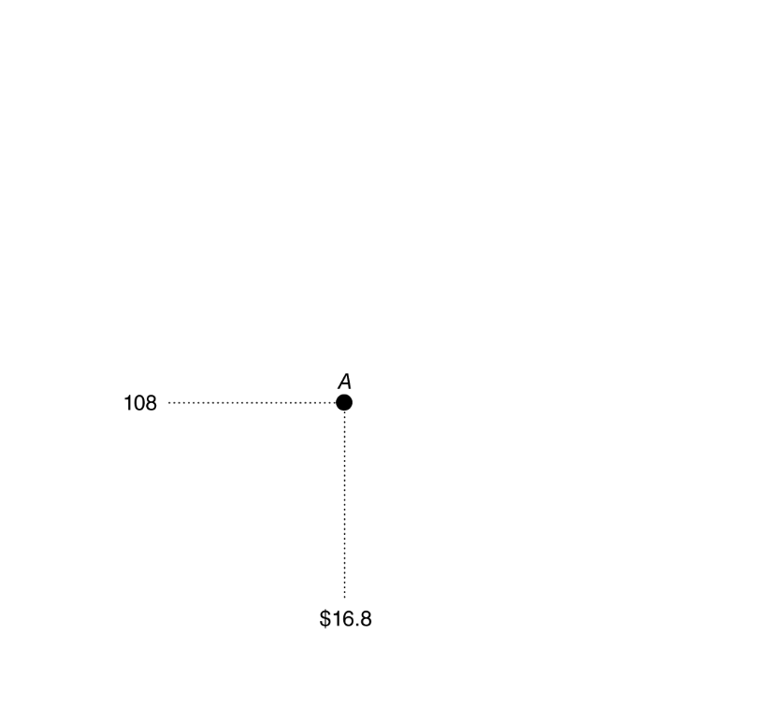

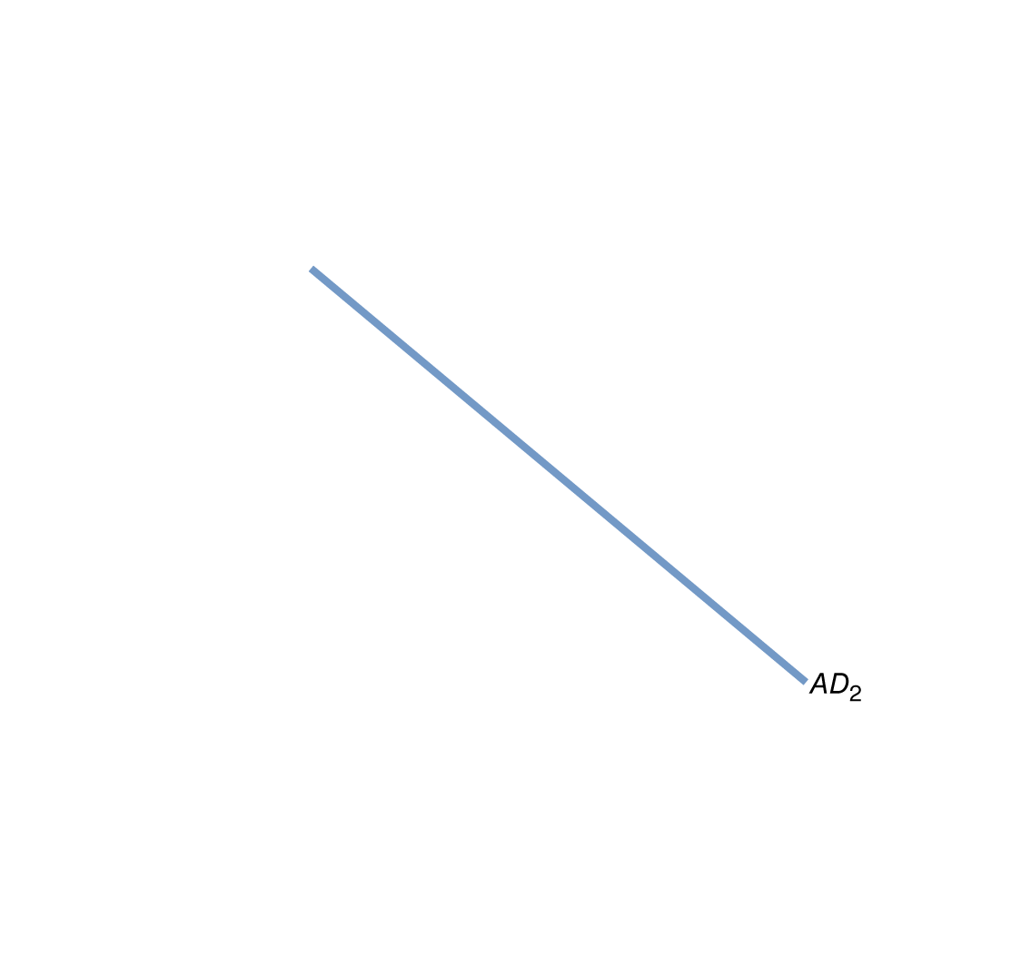
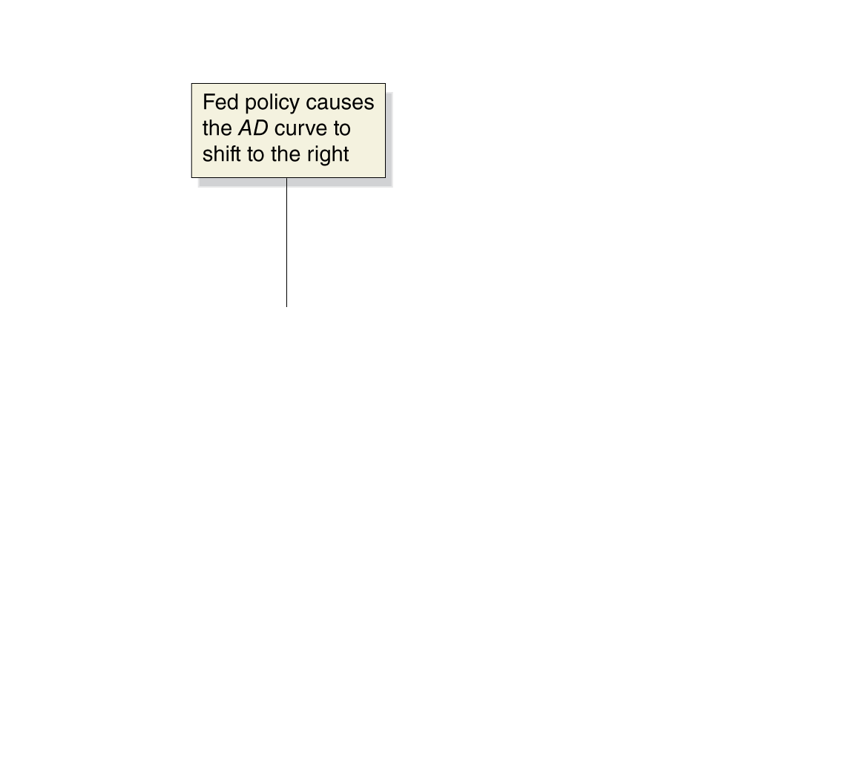
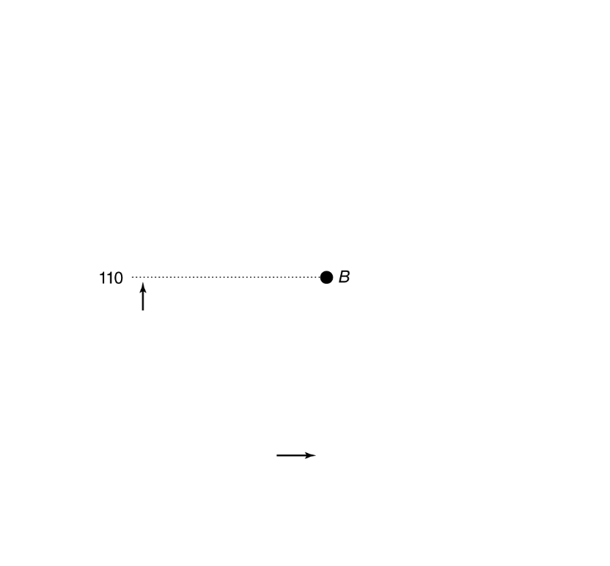
Expansionary monetary policy in the AD-AS model
The Fed conducts expansionary monetary policy when it takes actions to decrease interest rates to increase real GDP.
This works because decreases in interest rates raise consumption, investment, and net exports.
Figure 15.7a
Monetary policy
The Fed would take this action when short-run equilibrium real GDP was below potential real GDP.
The increase in aggregate demand encourages increased employment, one of the Fed’s primary goals.
Notes:
In panel (a), short-run equilibrium is at point A, with real GDP of $16.8 trillion
and a price level of 108. An expansionary monetary policy causes aggregate
demand
to shift to the right, from AD1 to AD2, increasing real GDP from
$16.8 trillion to $17.0 trillion and the price level from 108 to 110 (point B).
With real GDP back at its potential level, the Fed can meet its goal of high
employment.
In panel (b), short-run equilibrium is at point A, with real GDP at $17.2 trillion and
the price level at 112. Because real GDP is greater than potential GDP, the economy
experiences rising wages and prices. A contractionary monetary policy causes aggregate
demand to shift to the left, from AD1 to AD2, causing real GDP to decrease from
$17.2 trillion to $17.0 trillion and the price level to decrease from 112 to 110 (point
B). With real GDP back at its potential level, the Fed can meet its goal of price stability.

Slide 24

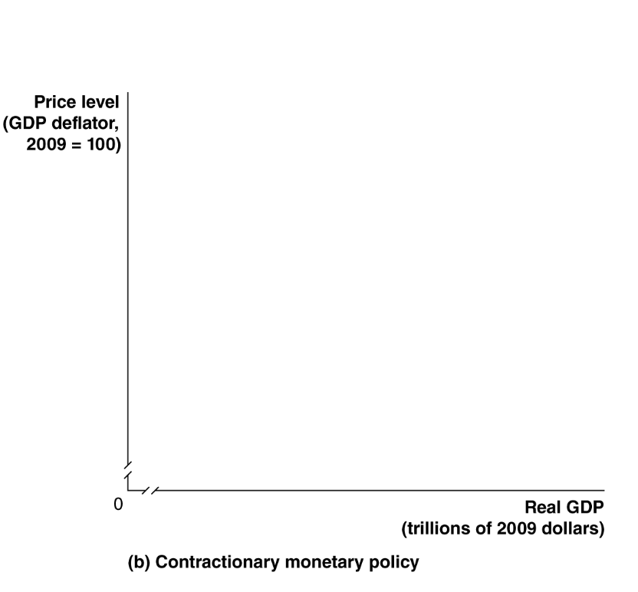
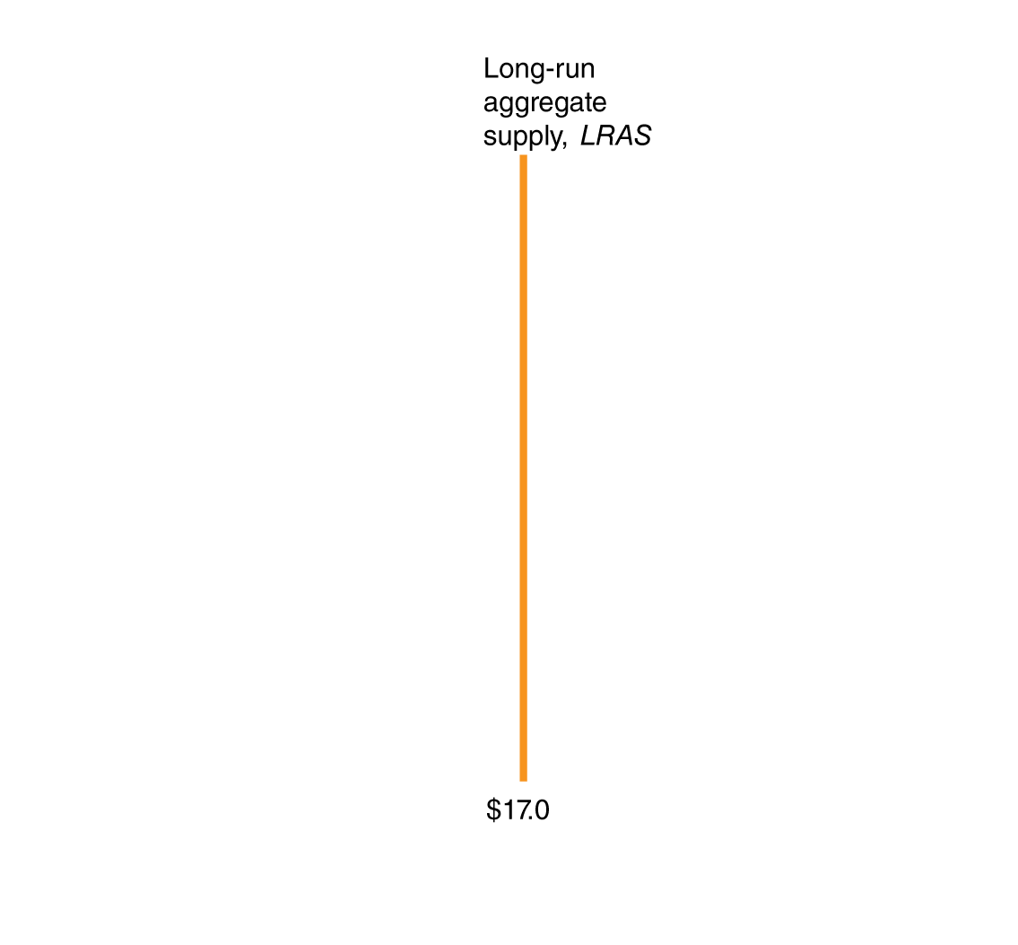
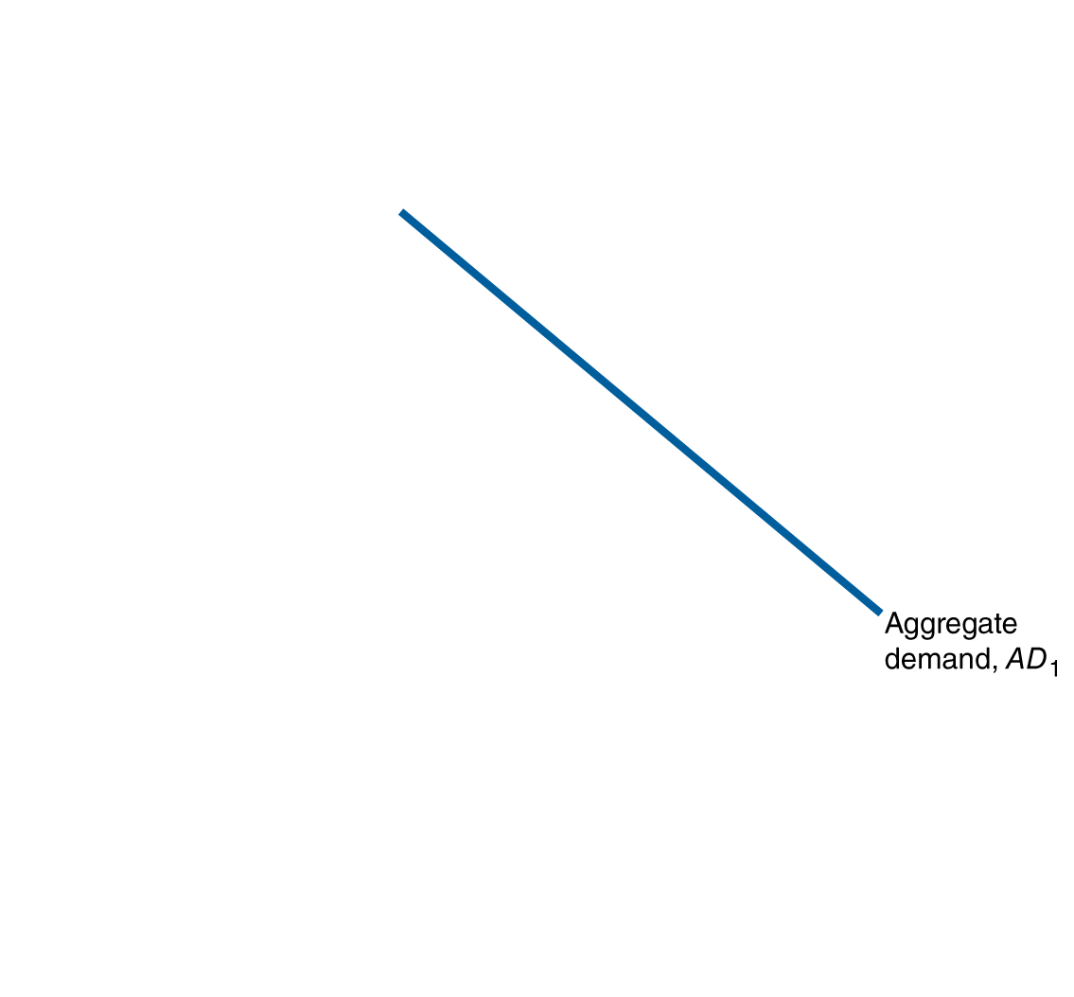
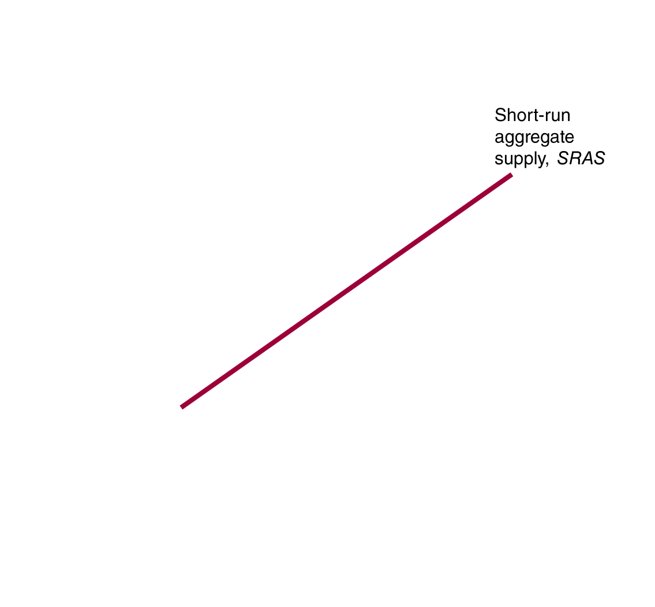
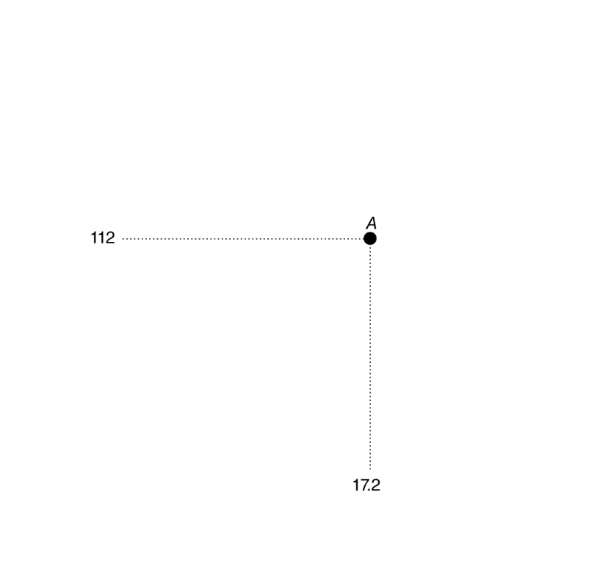

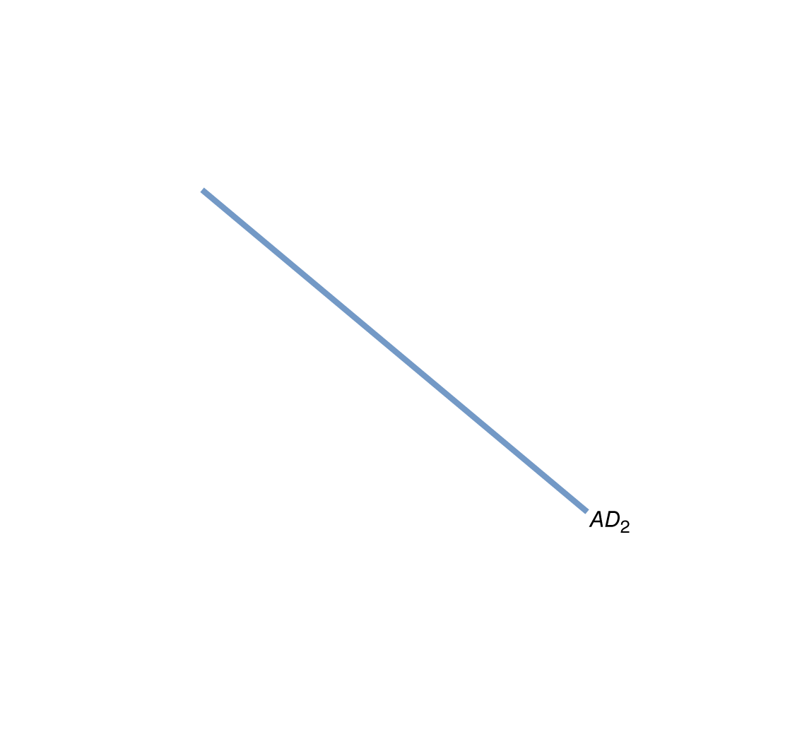
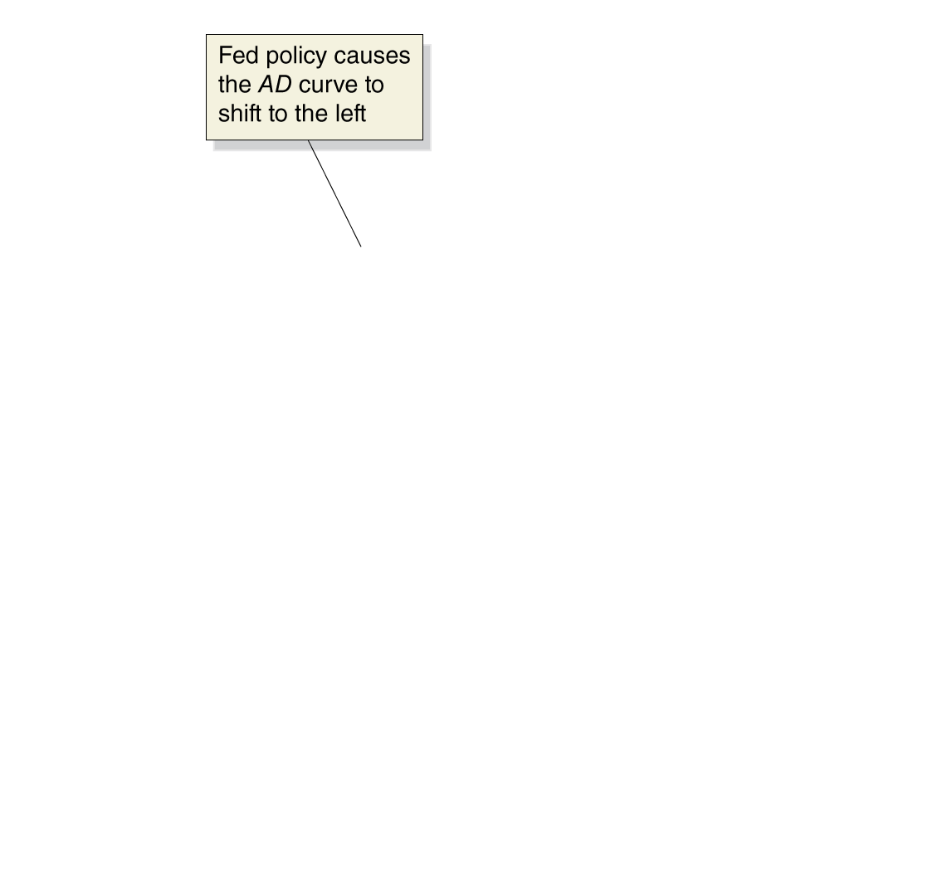
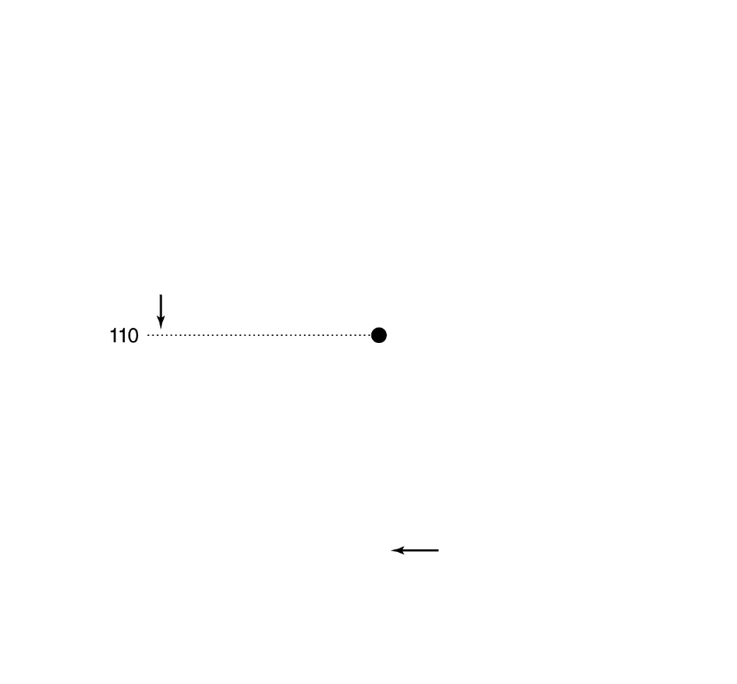
Contractionary monetary policy in the AD-AS model
Sometimes the economy may be producing above potential GDP.
In that case, the Fed may perform contractionary monetary policy: increasing interest rates to reduce inflation.
Why would the Fed intentionally reduce real GDP?
Figure 15.7b
Monetary policy
The Fed is mostly concerned with long-run growth. If it determines that inflation is a danger to long-run growth, it can contract the money supply in order to discourage inflation, i.e. encouraging price stability.

Slide 25
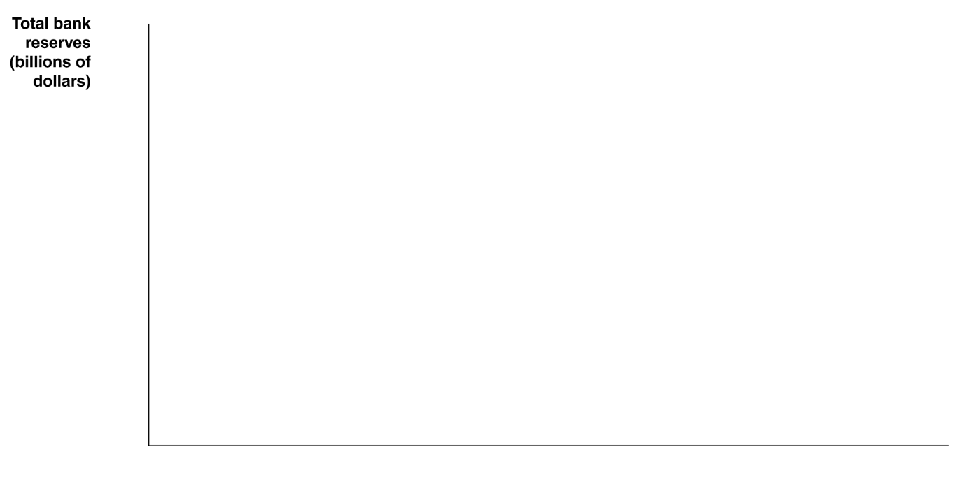

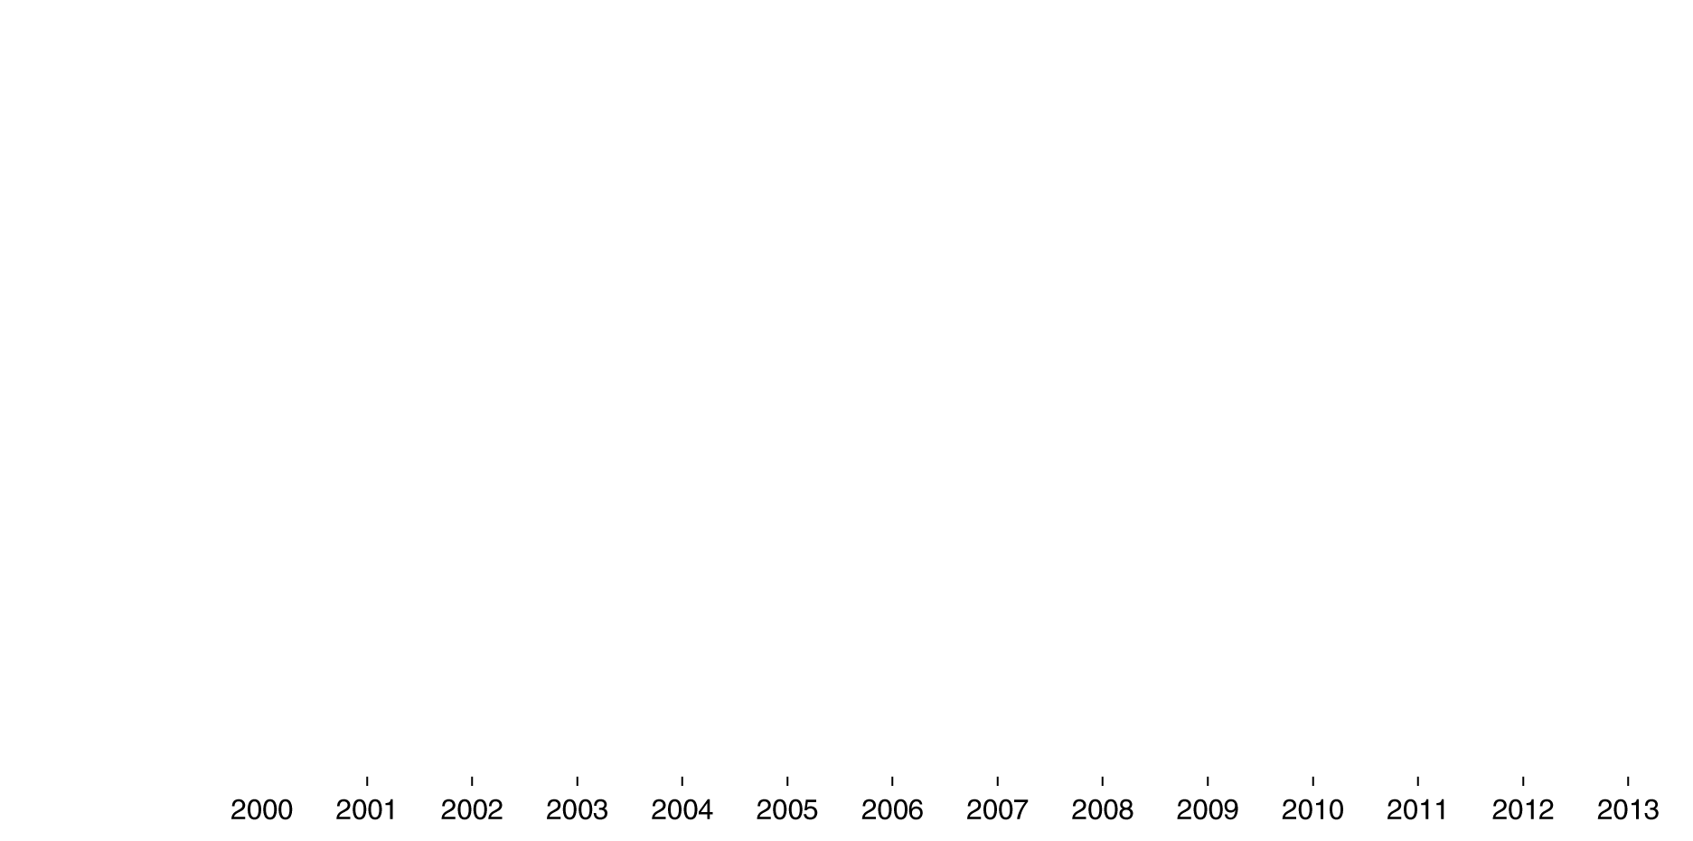



Quantitative easing and Operation Twist
Adjusting the federal funds rate had been an effective way for the Fed to stimulate the economy, but it began to fail in 2008.
Banks did not believe there were good loans to be made, so they refused to lend out reserves, despite the federal funds rate being maintained at zero. This is known as a liquidity trap: the Fed was unable to push rates any lower to encourage investment.

Slide 26
QE and Operation Twist—continued
But the Fed was certain the economy was below potential GDP, so it wanted to stimulate demand. It performed:
Quantitative easing: buying securities beyond the normal short-term Treasury securities, including 10-year Treasury notes and mortgage-backed securities. Ended June 2010.
More quantitative easing (QE2 and QE3): started November 2010; similar actions, planned to continue “at least through 2015”.
“Operation Twist”: purchasing long-term Treasury securities, and selling an equal amount of shorter-term securities; designed to decrease long-term interest rates, stimulating aggregate demand. Performed September 2011 onward.

Slide 27
Can the Fed eliminate recessions?
In our demonstration of monetary policy, the Fed
Knew how far to shift aggregate demand, and
Was able to shift aggregate demand exactly this far.
In practice, monetary policy is much harder to get right than the graphs make it appear.
Completely offsetting a recession is not realistic; the best the Fed can hope for is to make recessions milder and shorter.
Another complicating factor is that current economic variables are rarely known; we usually can only know them for the past—i.e. with a lag.
Example: In November 2001, NBER announced that the economy was in a recession that had begun in March 2001.
Several months later, it announced that the recession had ended… in November 2001.

Slide 28
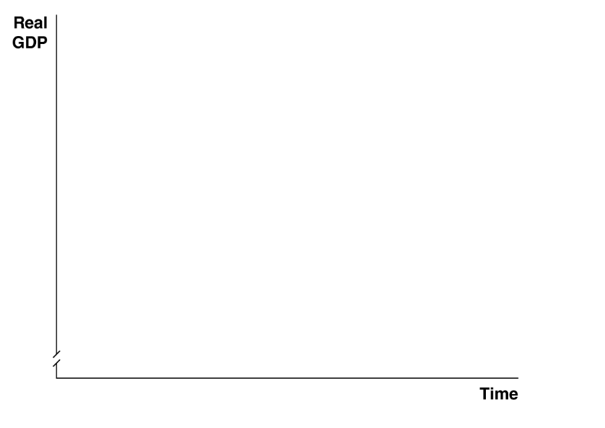

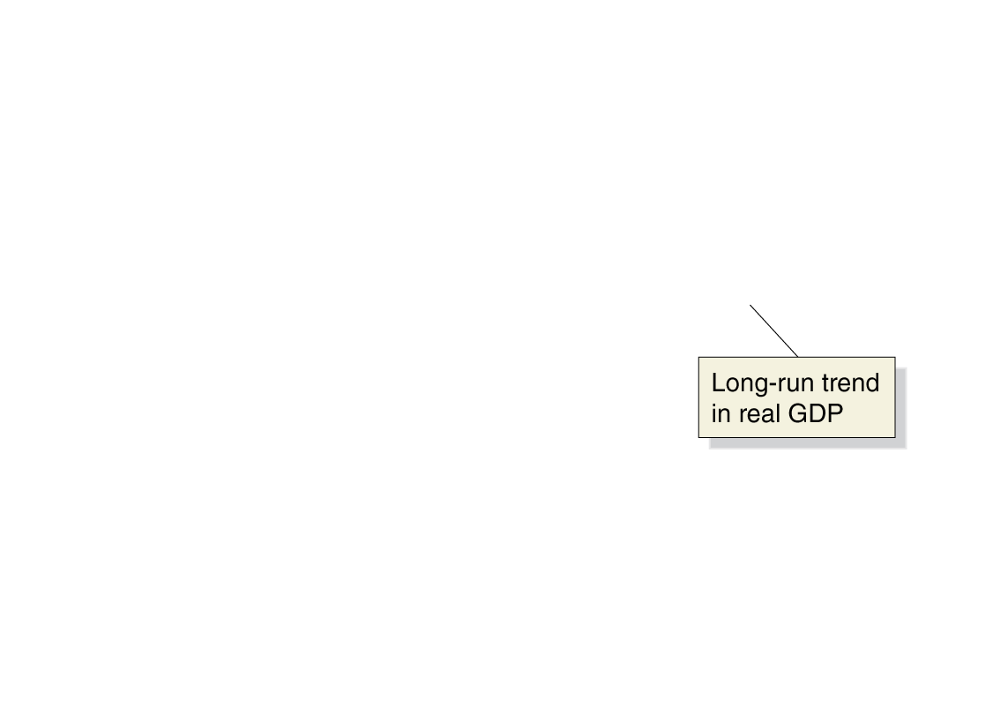
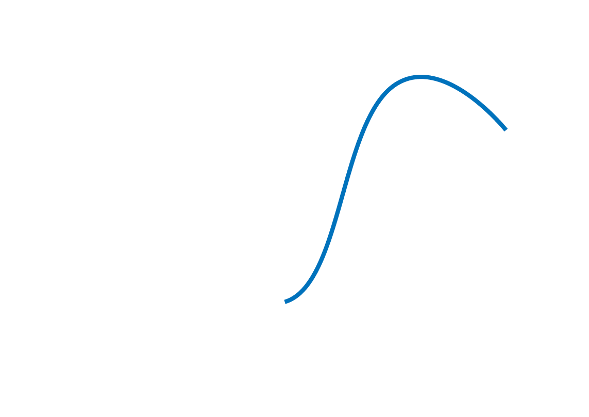


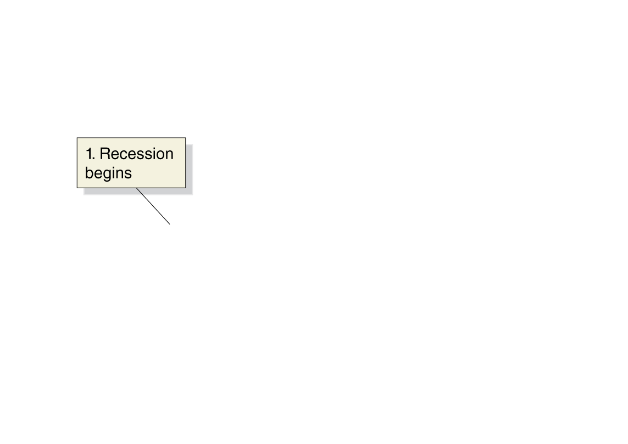
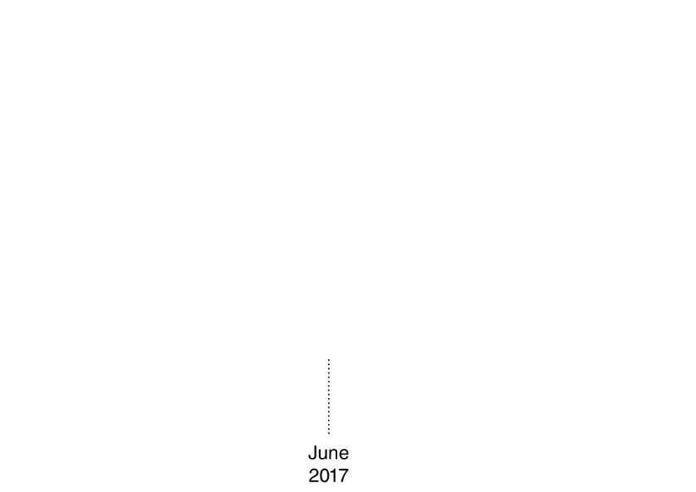
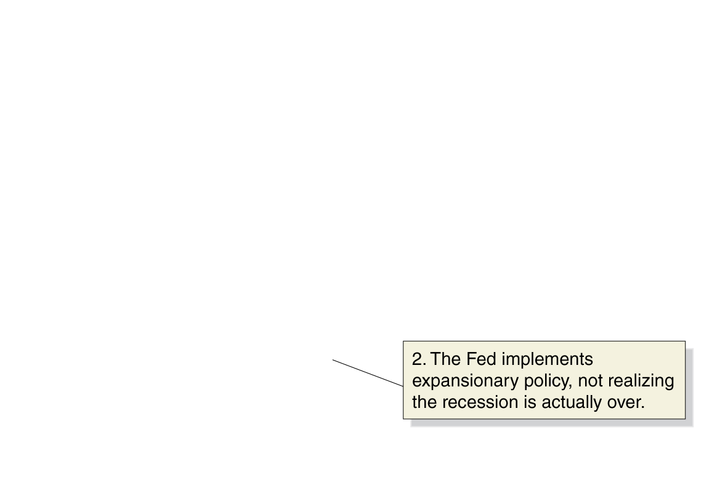

Poorly-timed monetary policy
Suppose a recession begins in August 2016.
The Fed finds out about the recession with a lag.
In June 2017, the Fed starts expansionary monetary policy; but the recession has already ended.
By keeping interest rates low for too long, the Fed encourages real GDP to go far beyond potential GDP. The result:
High inflation
The next recession will be more severe
Figure 15.8
The effect of a poorly timed monetary policy on the economy
Notes:
The upward-sloping straight line represents
the long-run growth trend in real GDP. The
curved red line represents the path real GDP
takes because of the business cycle. If the
Fed is too late in implementing a change in
monetary policy, real GDP will follow the
curved blue line. The Fed’s expansionary
monetary policy results in too great an increase
in aggregate demand during the next
expansion, which causes an increase in the
inflation rate.

Slide 29
Fed forecasts
The Fed tries to set policy according to what it forecasts the state of the economy will be in the future.
Good policy requires accurate forecasts.
The forecasts of most economists in 2006/2007 did not anticipate the severity of the coming recession.
So the Fed missed the opportunity to dampen the effects of the recession.
 | Forecast Growth Rate |  | Actual Growth Rate
Date Forecast Was Made | For 2007 | For 2008 | 2007 | 2008
February 2006 | 3% to 4% | No forecast | 1.8% | -0.3%
May 2006 | 2.5% to 3.25% | No forecast
February 2007 | 2.25% to 3.25% | 2.5% to 3.25%
July 2007 | No forecast | 2.5% to 3.0%
Table 15.1
Fed forecasts of real GDP growth during 2007 and 2008

Slide 30






Trying to hit a moving target
As if the Fed’s job wasn’t hard enough, it also has to deal with changing estimates of important economic variables.
GDP from the first quarter of 2001 was initially estimated to have increased by 2.0%. But the estimate changed over time.
Not only was it revised later in 2001, it was revised in 2002, 2003, 2004…and again in 2009… and in 2013!

Slide 31


A summary of how monetary policy works
a.k.a. “loose” or “easy” monetary policy
In each of these steps, the changes are relative to what would have happened without the monetary policy.
a.k.a. “tight” monetary policy
Table 15.2
Expansionary and contractionary monetary policies

Slide 32
Monetary Policy in the Dynamic Aggregate Demand and Aggregate Supply Model
15.4
Use the dynamic aggregate demand and aggregate supply model to analyze monetary policy.

Slide 33
Monetary policy in the dynamic AD-AS model
We used the static AD-AS model initially for simplicity.
But in reality, potential GDP increases every year (long-run growth); and the economy generally experiences inflation every year.
We can account for these in the dynamic aggregate demand and aggregate supply model. Recall that this features:
Annual increases in long-run aggregate supply (potential GDP)
Typically, larger annual increases in aggregate demand
Typically, smaller annual increases in short-run aggregate supply
Typically, therefore, annual increases in the price level

Slide 34













Expansionary monetary policy in the dynamic model
In period 1, the economy is in long-run equilibrium at $17.0 trillion.
The Fed forecasts that aggregate demand will not rise fast enough, so that in period 2, the short-run equilibrium will fall below potential GDP, at $17.3 trillion.
So the Fed uses expansionary monetary policy to increase aggregate demand.
The result: real GDP at its potential; and a higher level of inflation than would otherwise have occurred.
Figure 15.9
An expansionary monetary policy
Notes:
Initially, equilibrium is at point A, with
real GDP of $17.0 trillion and a price level
of 110. Without monetary policy, aggregate
demand will shift from AD1 to AD2(without
policy), which is not enough to keep the economy
at full employment because long-run
aggregate supply has shifted from LRAS1 to
LRAS2. Short-run equilibrium is at point B,
with real GDP of $17.3 trillion and a price
level of 112. By lowering interest rates, the
Fed increases investment, consumption, and
net exports sufficiently to shift aggregate
demand to AD2(with policy). Equilibrium will
be at point C, with real GDP of $17.4 trillion,
which is its full employment level, and
a price level of 113. The price level is higher
than it would have been if the Fed had not
acted to increase spending in the economy.

Slide 35

















Expansionary monetary policy in the dynamic model
In 2005, the Fed believed the economy was in long-run equilibrium.
In 2006, the Fed believed aggregate demand growth was going to be “too high”, resulting in excessive inflation.
So the Fed raised the federal funds rate—a contractionary monetary policy, designed to decrease inflation.
The result: lower real GDP and less inflation in 2006, than would otherwise have occurred.
Figure 15.10
A contractionary monetary policy in 2006
Notes:
In 2005, equilibrium is at point A, with real
GDP equal to potential GDP of $14.2 trillion
and a price level of 92.0. From 2005 to 2006,
potential GDP increased from $14.2 trillion
to $14.5 trillion, as long-run aggregate supply
increased from LRAS2005 to LRAS2006.
The Fed raised interest rates because it
believed the housing boom was causing
aggregate demand to increase too rapidly.
Without the increase in interest rates, aggregate
demand would have shifted from
AD2005 to AD2006(without policy), and the new
short-run equilibrium would have occurred
at point B. Real GDP would have been $14.8
trillion—$300 billion greater than potential
GDP—and the price level would have been
96.1. The increase in interest rates resulted
in aggregate demand increasing only to
AD2006(with policy). Equilibrium occurred at
point C, with real GDP of $14.6 trillion being
only $100 billion greater than potential
GDP and the price level rising only to 94.8.

Slide 36
A Closer Look at the Fed’s Setting of Monetary Policy Targets
15.5
Discuss the Fed’s setting of monetary policy targets.

Slide 37
What should the Fed target?
In normal times, the Fed targets the federal funds rate.
Should it use the money supply as its monetary policy target instead?
Monetarists, led by Nobel Laureate Milton Friedman, said “yes”.
Friedman advocated a monetary growth rule, increasing the money supply at about the long-run rate of real GDP growth.
He argued that an active countercyclical monetary policy would serve to destabilize the economy; the monetary growth rule would provide stability instead.
Monetarism was popular in the 1970s; but since the 1980s, the link between the money supply and real GDP seems to have broken down: M1 seems to change “wildly”, but real GDP and inflation do not react in the same way.
Now, targeting the money supply is not seriously considered.

Slide 38





Why not do both?
It might seem that the Fed could “get the best of both worlds” by targeting both interest rates and the money supply.
But this is impossible: the two are linked through the money demand curve.
So a decrease in the money supply will increase interest rates; an increase in the money supply will increase interest rates.
Figure 15.11
The Fed can’t target both the money supply and the interest rate
Notes:
The Fed is forced to choose between using
either the interest rate or the money supply
as its monetary policy target. In this figure,
the Fed can set a target of $900 billion for
the money supply or a target of 5 percent
for the interest rate, but the Fed can’t hit
both targets because it can achieve only
combinations of the interest rate and the
money supply that represent equilibrium in
the money market.

Slide 39
The Taylor rule
The Taylor rule is a rule developed by John Taylor of Stanford University, that links the Fed’s target for the federal funds rate to economic variables. Taylor estimates that:
Federal funds target rate = Current inflation rate
+ Real equilibrium federal funds rate
+ ((1/2) × Inflation gap)
+ ((1/2) × Output gap)
Estimate of the inflation-adjusted federal funds rate that would be consistent with maintaining real GDP at its potential level in the long run.
Difference between current inflation and the Fed’s target rate of inflation; could be positive or negative.
Difference between current real GDP and the potential GDP; could be positive or negative.

Slide 40
The Taylor rule
The Taylor rule is a rule developed by John Taylor of Stanford University, that links the Fed’s target for the federal funds rate to economic variables. Taylor estimates that:
Federal funds target rate = Current inflation rate
+ Real equilibrium federal funds rate
+ ((1/2) × Inflation gap)
+ ((1/2) × Output gap)
The weights of (1/2) would be different if the Fed was more or less concerned about the inflation gap or the output gap.
The Taylor rule was a good predictor of the federal funds target rate during Alan Greenspan’s tenure as Fed chairman (1987-2006); however during the mid-2000s, the actual federal funds rate was lower than the Taylor rule predicts.
Some economists argue this led to excessive increases in spending on housing.

Slide 41
Should the Fed target inflation instead?
An alternative to targeting interest rates or the money supply is to target inflation.
Inflation targeting: Conducting monetary policy so as to commit the central bank to achieving a publicly announced level of inflation.
This policy has been adopted by central banks in some other countries, including Canada and the UK, and by the European Central Bank.
The typical outcome of adopting inflation targeting appears to be that inflation is lower, but unemployment is (temporarily) higher.
In 2012, the Fed announced its first explicit inflation target: an average inflation rate of 2% per year.

Slide 42
Arguments for and against inflation targeting
For inflation targeting:
Makes it clear that the Fed cannot affect real GDP in the long run.
Easier for firms and households to form expectations about future inflation, improving their planning.
Reduces chance of abrupt changes in monetary policy (for example, when members of the FOMC change).
Promotes Fed accountability.
Against inflation targeting:
Reduces the Fed’s flexibility to address other policy goals.
Assumes the Fed can correctly forecast inflation rates, which may not be true.
Increased focus on inflation rate may result in Fed being less likely to address other beneficial goals.

Slide 43






How does the Fed measure inflation?
Which inflation rate does the Fed actually pay attention to?
Not the CPI: it is too volatile.
It used to use the PCE (personal consumption expenditures) index, a price index based on the GDP deflator.
But since 2004, it has used the “core PCE”: the PCE without food and energy prices. The core PCE is more stable; the Fed believes it estimates true long-run inflation better.

Slide 44
Fed Policies during the 2007–2009 Recession
15.6
Discuss the policies the Federal Reserve used during the 2007–2009 recession.

Slide 45
Asset price bubbles
A bubble in a market refers to a situation in which prices are too high relative to the underlying value of the asset.
Bubbles can form due to:
Herding behavior: failing to correctly evaluate the value of the asset, and instead relying on other people’s apparent evaluations; and/or
Speculation: believing that prices will rise even higher, and buying the asset intending to sell it before prices fall.
Example: Stock prices of internet-related companies were “optimistically” high in the late 2000s, before the “dot-com bubble” burst, starting in March 2000.

Slide 46







The housing market bubble of the 2000s
By 2005, many economists argued that a bubble had formed in the U.S. housing market.
Comparing housing prices and rents makes it clear now that this was true.
The high prices resulted in high levels of investment in new home construction, along with optimistic sub-prime loans.
Figure 15.12
Housing prices and housing rents
Notes:
Typically, housing prices increase at about the same rate as housing rents. But
during
the housing bubble, housing prices increased far more than did rents.
Note: For both series, the values for the first quarter of 1987 (1987:I) are set equal to 100.
Source: Federal Reserve Bank of St. Louis.

Slide 47




The bursting of the housing market bubble
During 2006 and 2007, house prices started to fall, in part because of mortgage defaults, and new home construction fell considerably.
Banks became less willing to lend, and the resulting credit crunch further depressed the housing market.
Figure 15.13
The housing bubble
Notes:
Sales of new homes in the United States went on a roller-coaster ride, rising by
60 percent between January 2000 and July 2005, before falling by 80 percent
between July 2005 and May 2010.
Note: The data are seasonally adjusted at an annual rate.
Source: U.S. Bureau of the Census.

Slide 48
The changing housing market
Until the 1970s, when a commercial bank granted a mortgage, it would “keep” the loan until it was paid off.
This limited the number of mortgages banks were willing to provide.
A secondary market in mortgages was made possible by the formation of the Federal National Mortgage Association (“Fannie Mae”) and the Federal Home Loan Mortgage Corporation (“Freddie Mac”).
These government-sponsored enterprises (GSEs) sell bonds to investors and use the funds to purchase mortgages from banks.
This allowed more funds to flow into mortgage markets.

Slide 49
The role of investment banks
By the 2000s, investment banks had started buying mortgages also, packaging them as mortgage-backed securities, and reselling them to investors.
These securities were appealing to investors because they paid high interest rates with apparently low default risk.
But with more money flowing into mortgage markets, “worse” loans started to be made, to people
With worse credit histories (sub-prime loans)
Without evidence of income (“Alt-A” loans)
With lower down-payments
Who couldn’t initially afford traditional mortgages (adjustable-rate mortgages start with low interest rates)

Slide 50

The wonderful world of leverage
Why does the size of the down-payment matter?
By owning a house, you become exposed to increases or decreases in the price of that large asset.
With a smaller down-payment, you are said to be highly leveraged, exposed to large potential changes in the value of your investment.
Return on your Investment as a result of . . .
Down Payment | A 10 percent increase in the price of your house | A 10 percent decrease in the price of your house
100% | 10% | −10%
20 | 50 | −50
10 | 100 | −100
5 | 200 | −200

Slide 51
Result of the lower-quality loans
When the housing bubble burst, more of these lower-quality loans were defaulted on than investors were expecting.
The market for securities based on these loans became very illiquid—few people or firms were willing to buy them, and their prices fell quickly.
Many commercial and investment banks were invested heavily in these mortgage-backed securities, and so suffered heavy losses.
These problems were so profound that the Fed and the U.S. Treasury decided to take unprecedented actions.

Slide 52
Initial Fed and Treasury actions
(March 2008) The Fed made discount loans available to primary dealers including investment banks.
(March 2008) The Fed announced that it would loan up to $200 billion of Treasury securities in exchange for mortgage-backed securities.
(March 2008) The Fed aided JPMorgan Chase’s acquisition of failing investment bank Bear Stearns, guaranteeing a portion of Bear Stearns’ potential losses.
(September 2008) Federal government took control of Fannie Mae and Freddie Mac, providing an injection of cash ($100 billion) for 80% ownership, further supporting the housing market.

Slide 53
Responses to the failure of Lehman Brothers
Many economists were critical of the Fed underwriting Bear Stearns, as managers would now have less incentive to avoid risk: a moral hazard problem.
So in September 2008, the Fed did not step in to save Lehman Brothers, another investment bank experiencing heavy losses. This was supposed to signal to firms not to expect the Fed to save them from their own mistakes.
Lehman Brothers declared bankruptcy on September 15.
Financial markets reacted adversely—more strongly than expected.
When AIG began to fail a few days later, the Fed reversed course, providing them with a $87 billion loan.

Slide 54
More consequences of Lehman Brothers
Reserve Primary Fund was a money market mutual fund that was heavily invested in Lehman Brothers.
Many investors withdrew money from Reserve and other money market funds, fearing losing their investments.
This prompted the Treasury to offer insurance for money market mutual funds, similar to FDIC insurance.
Finally, in October 2008, Congress passed the Troubled Asset Relief Program (TARP), providing funds to banks in exchange for stock—another unprecedented action.
Although these interventions took new forms, they were all designed to achieve traditional macroeconomic goals: high employment, price stability, and financial market stability.

Slide 55
Common misconceptions to avoid
Although we talk of monetary policy as causing “increases” and “decreases” in economic variables, it is more correct to think of the policy as increasing or decreasing those variable relative to what they would have been without the policy.
Be careful to distinguish commercial banks—which take deposits from and make loans to households and firms—from investment banks, which are typically involved in underwriting and/or issuing securities.
The Fed cannot control both the money supply and interest rates simultaneously.

